Slide 1
Simulation
introduction

Slide 2
Systems vs. Models
System is a real object, process, phenomenon, etc.
Model is an accurate or approximate (in most cases) description of the system.
Modeling is:
Process of model building ;
Analysis of the model, e.g. obtaining results using the model.

Slide 3
Types of Modeling
!
Physical
Mathematical
Computer
Analytical
Numerical
Simulation

Slide 4
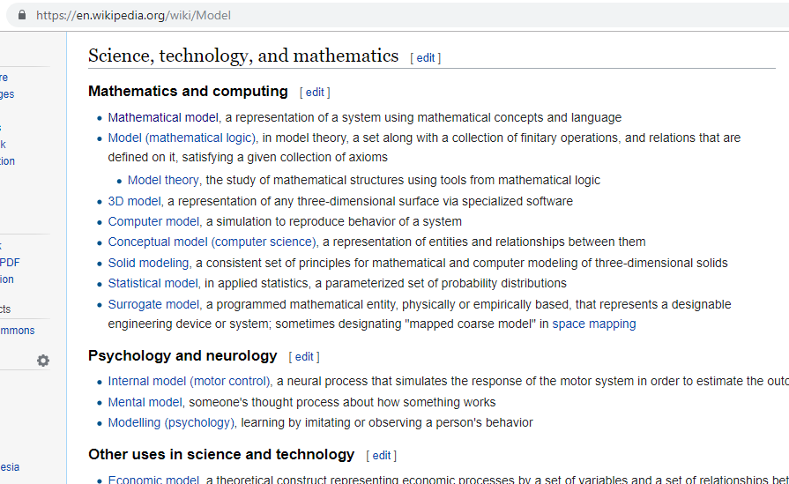

Slide 5
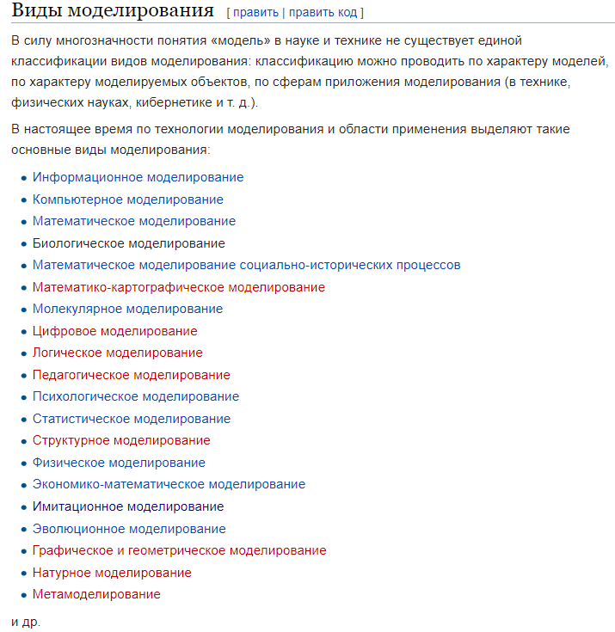

Slide 6
Simulation Model
is a model of algorithm of real system evolution
Typical features of a simulation model:
Modeling time, time slot, state of the model is calculated at special moments of time.
Result is numerical.
There is error in calculation. In most cases it depends on time slot and/or amount of resulting data (for stochastic models).

Slide 7
Simulation
Purposes
Obtain characteristics of system evolution in numerical form
Visualization of system evolution
Fields of application
Research
Computer games

Slide 8
What we should do before starting simulation?
Determine goals: what we expect from simulation?
Build mathematical model.
Choose simulation method(s).
Determine input and output parameters.
Determine how we will analyze accuracy of results.

Slide 9
Types of Simulation Modeling
(common classification)
Continuous simulation
Discrete-event modeling
System dynamics
Agent-based modeling

Slide 10
Simulation methods
Deterministic modeling
Stochastic modeling
Discrete-event modeling
System dynamics
Agent-based modeling

